Slide 1
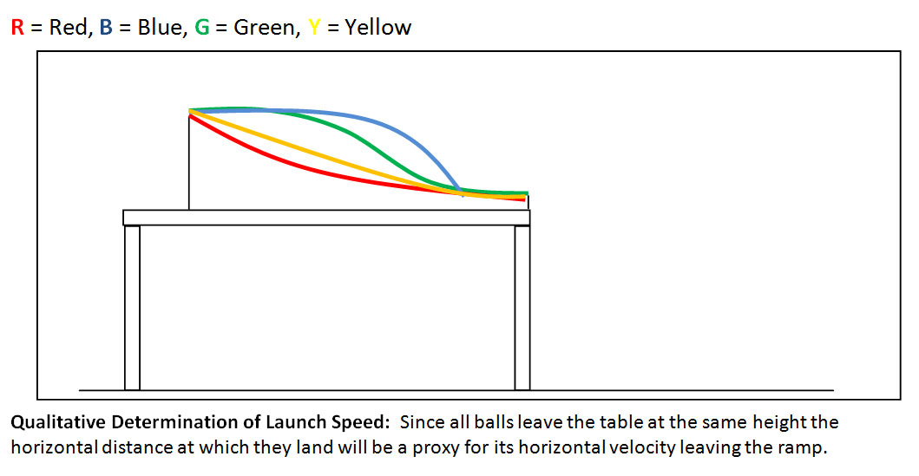
Amazing Race!
Which track profile will result in the fastest speed of marble when rolled from rest from the top?

Slide 2
Let’s do a Poll!
Go to the website below and write your response.
bit.ly/12tzrs8

Slide 3
Explanation
The ramps are all the same height
the marble possesses the same GRAVITATIONAL POTENTIAL energy on each track
The potential energy is converted into KINETIC ENERGY
Since the same amount of GPE is converted into KE and KE is related to SPEED, the ball has the same speed from each profile.

Slide 4
Conservation of Energy

Slide 5
Conservation of energy
In a closed system the total amount of mechanical energy does not change (i.e. remains constant) it is only transformed from one form to another.

Slide 6
Energy Conservation: everywhere!
Pendulum of Doom!
Do you trust the law of energy conservation?

Slide 7
Honda Ad

Slide 8
Honda Ad Spoof

Slide 9
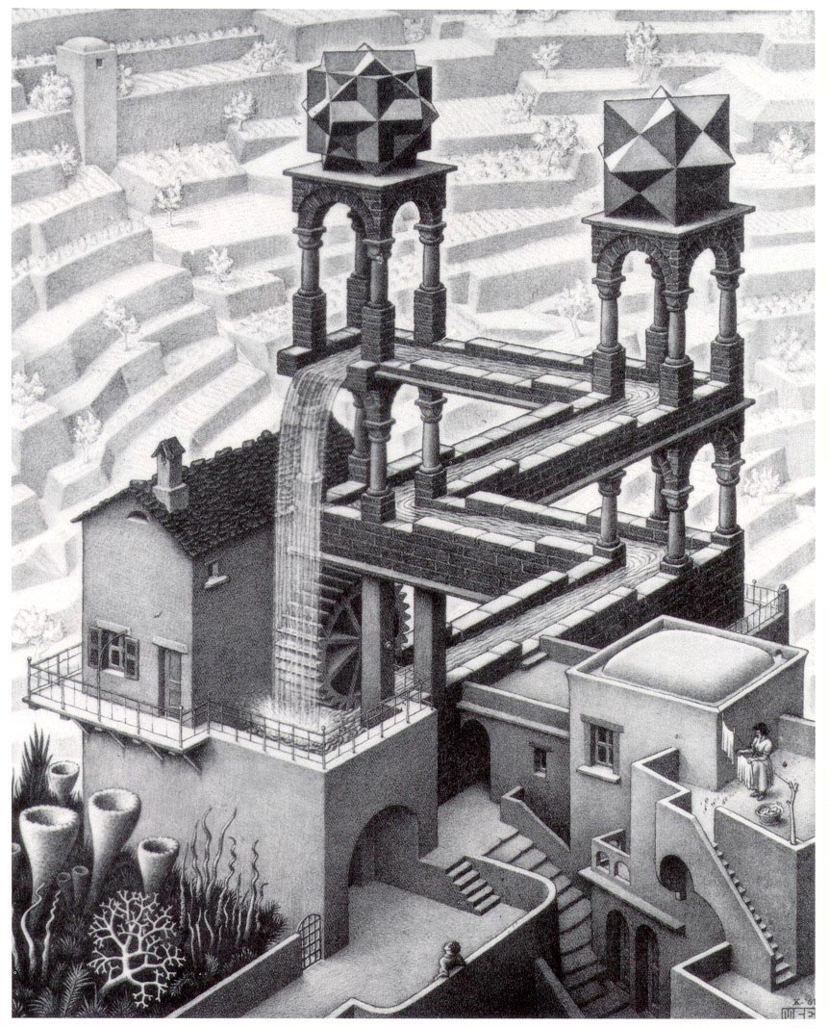
Perpetual Motion
Is it possible to build a machine that once set in motion requires zero energy input in order to continue moving forever ?
(perpetual = forever)

Slide 10
2nd Law of Thermodynamics
Perpetual motion is theoretically impossible…
In every energy transfer some energy is always lost to random motion of molecules (heat).
perpetual motion is theoretically impossible.

Slide 11
Forms of Energy Loss
Energy “loss” is really just energy that is transformed into unusable forms. The energy is not really lost; this is a misconception
Frictional heat
Sound
Deformation (crumpling, bending, flexing, etc.)
Light (radiation)
Heat

Slide 12
Total Mechanical Energy
Potential Energy
Kinetic Energy
Total Mechanical Energy
TME = PE + KE

Slide 13
Roller Coaster
Notice how the TME remains constant while the KE and PE change depending where the cart is in its path on the profile.

Slide 14
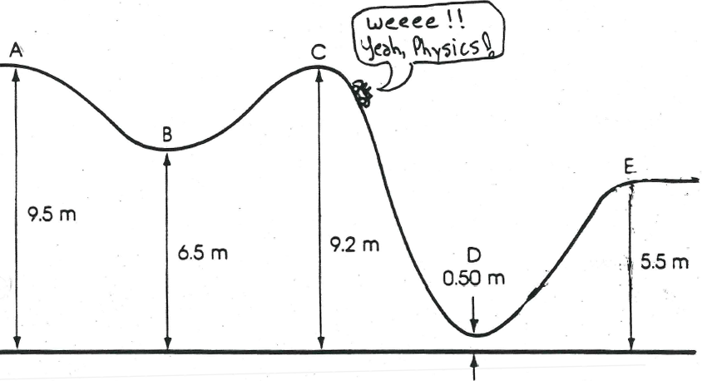
Roller Coaster Problem
A 1000kg roller coaster, with its passengers, starts from rest at point A on a frictionless track whose profile is shown in the diagram.
Determine the Gravitational Potential , Kinetic Energy, Velocity and Total Energy at each point; also determine the speed at each point.

