Slide 1
Law of Intertia
Newton’s First Law
Inertia is a measure of an object’s resistance to change in motion.
An object at rest tends to stay at rest
An object in motion tends to stay in motion
An object’s motion is only changed if an external force acts on it
Mass is a measure of inertia
Inertia can be better formalized as a resistance to change in motion
More mass → more inertia (more resistance to change in motion)

Slide 2
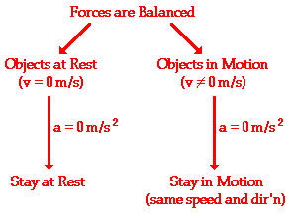
Conditions…

Slide 3
Newton’s first law
Skateboard Basket Transfer
http://www.youtube.com/watch?v=ohC_vunbUAA

Slide 4
NEWTON’S FIRST LAW
Car Seatbelts and Head-rests
http://www.youtube.com/watch?v=8zsE3mpZ6Hw

Slide 5
NEWTON’S FIRST LAW
“They’ve gone to plaid!”
http://www.youtube.com/watch?v=mk7VWcuVOf0

