Slide 1
POWER & Efficiency
The power of physics!

Slide 2
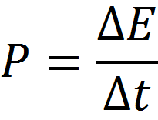
Power
Power is simply the rate at which work (change in energy) is done.
Units: J/s or Watts (W)

Slide 3
Maximizing power
ΔE
In order to maximize power...
Do a lot of work (large change in energy) in a short period of time!!
P=

Slide 4
Efficiency
When energy is transformed from one form into another (work), none of the energy is destroyed (conservation law). However, some is transferred into non-useful forms of energy (heat, sound, etc.)
The goal of most engineering companies and businesses is to improve machine efficiency in order to reduce “waste” energy.

Slide 5
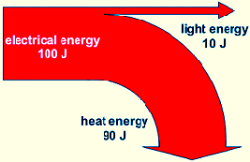
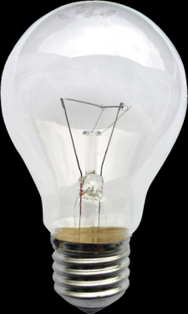
Lightbulb efficiencies
Incandescent Bulb
10% efficient

Slide 6
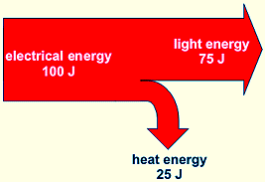
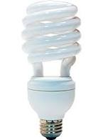
Lightbulb efficiencies
Compact Fluorescent Bulb
75% efficient

Slide 7
Efficiency equation
The ratio of input energy to useful output energy is a measure of the efficiency.

