Slide 1
Space Definitions

Slide 2
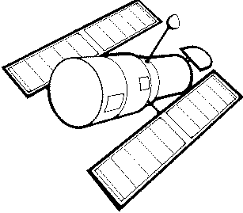
Astronomy
The science that studies the universe beyond the earth’s atmosphere

Slide 3
Universe
All matter and space everywhere
From electrons on Earth to galaxies far away

Slide 4
Constellations
Groups of stars, which are visible from earth, to which definite names have been given

Slide 5
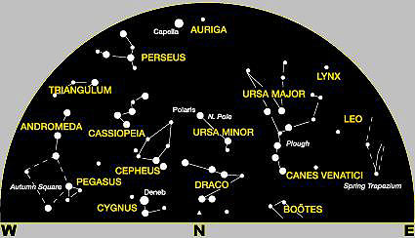
Constellations cont.
There are eighty eight official constellations.
Some examples are: Big dipper, Orion, Gemini, Little dipper.

Slide 6
Are stars still present in the sky during the day time?
Yes, we just can’t see them because their dim light is overwhelmed by the brightness of the sun during the day.

Slide 7
Circumpolar
Stars that can be seen all night and all year long.
They do not rise and set, but circle the north pole.

Slide 8
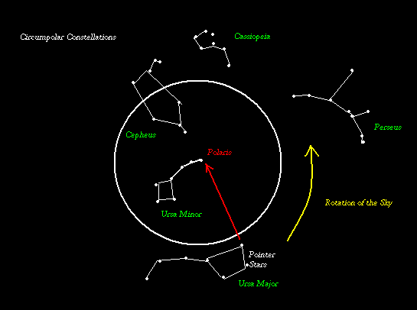
Circumpolar Constellations

Slide 9
Time Lapse – Night Sky - Polaris

Slide 10
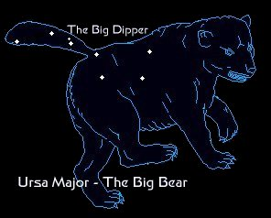
Ursa Major Circumpolar Constellation
The story behind it:
Callisto was changed to a bear because of Zeus's jealousy and transferred her to the sky.

Slide 11
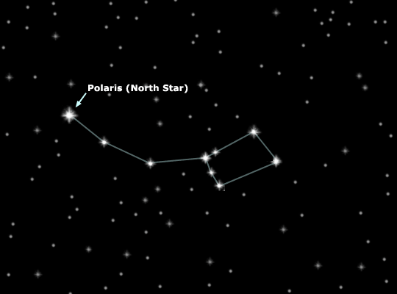
Ursa Minor Circumpolar Constellation

Slide 12
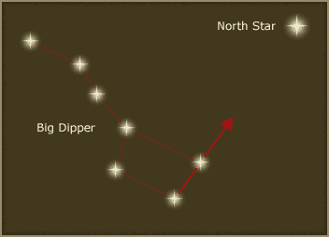
How to find the North Star

Slide 13
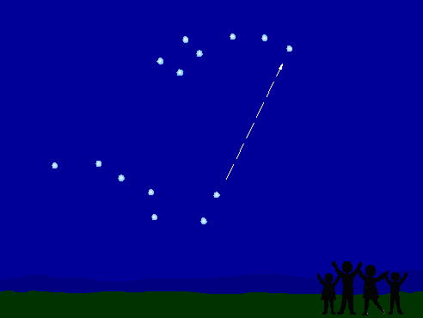

Slide 14
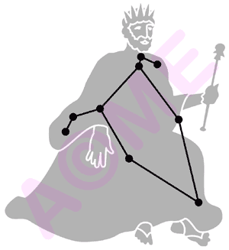
Cepheus Circumpolar Constellation

Slide 15
Cepheus
The story behind it:
Cepheus was the King of Ethiopia. He married Cassiopeia and they had a daughter Andromeda. Cassiopeia was incredibly beautiful but immensely vain. She was also proud of her daughter's beauty. In fact she continually boasted that the two of them were more beautiful than any of the fifty sea nymphs who attended Poseidon's court.
These nymphs (the Nereids) complained to Poseidon, who felt he had to defend his own reputation. So he sent a flood to devastate Cepheus' kingdom. The oracles told Cepheus that in order to save his people he must sacrifice his daughter to a great sea monster: Andromeda was tied to a rock along the coastline, dressed only in her jewelry. The monster would be along in due time to take his prize.
At that moment Perseus came flying by. He had just killed the Gorgon Medusa and was carrying the severed head back to Athene. To make a long story short, he saved her then turned everyone into stone by showing them the severed head.
Poseidon then put the stone frozen Cepheus and Cassiopeia into the heavens, but with a twist: he made the vain Cassiopeia spin around on her chair, spending half the year upside down. As for Cepheus, Poseidon gave him a number of medium sized stars that go to make his square face with a pointed crown.

Slide 16
Cassiopeia
This constellation is at the edge of the Milky Way galaxy and has the shape of a "W".
The story behind it:
Cassiopeia had been the wife of Cepheus (King of Ethiopia). Because she thought herself more beautiful than the daughters of Nereus, a god of the sea, she angered the god Poseidon. To punish her, Cassiopeia’s daughter was chained to a rock of the coast as a sacrifice for a sea monster and to learn humility Cassiopeia was banned to the sky hanging half of the time head downward.

Slide 17
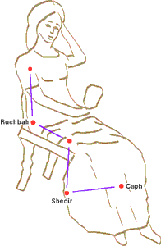
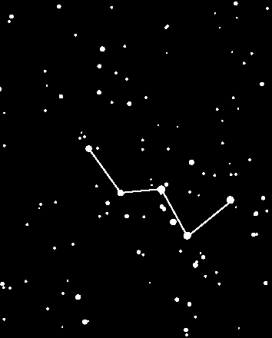
Cassiopeia Circumpolar Constellation

Slide 18
Draco
Draco, the Dragon, runs between Ursa Major and Ursa Minor.
The story behind it:
The dragon is the guardian of the 'golden apples' of immortality which grew in the garden of Hesperides, beyond the River of Time, in the land of death. It is Draco which Hercules kills in his to get the golden apples.

Slide 19
Circumpolar Constellations

Slide 20
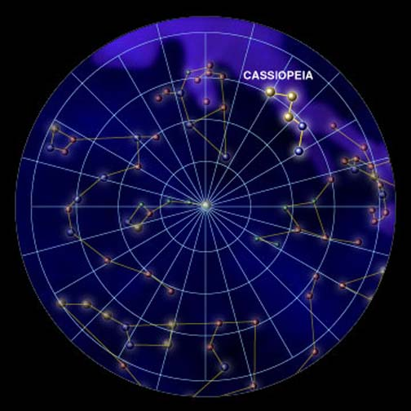
Circumpolar Constellations

Slide 21
Circumpolar Constellations

Slide 22
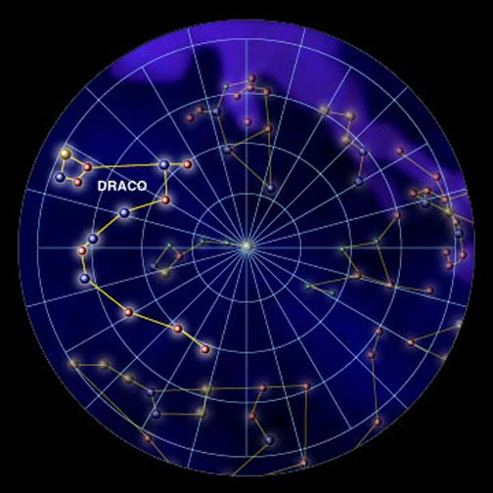
Circumpolar Constellations

